Slide 1
FIT1045 Introduction to Algorithms and Programming Lecture 6 Finding an Algorithm
COMMONWEALTH OF AUSTRALIA
Copyright Regulations 1969
WARNING
This material has been reproduced and communicated to you by or on behalf of Monash University pursuant to Part VB of the Copyright Act 1968 (the Act).The material in this communication may be subject to copyright under the Act.Any further reproduction or communication of this material by you may be the subject of copyright protection under the Act.
Do not remove this notice.

Slide 2
Overview
Main Steps
Fake Coin
Another Problem

Slide 3
Main Steps
Understand the Problem
Devise a plan
Carry out the plan
Review the plan

Slide 4
Understand the Problem
What is known?
What are the parameters?
What is required?
Understand the connection between what is known and unknown.

Slide 5
Devise a plan
Look at a smaller example.
Is there a related problem?
Is there a familiar problem having the same unknowns?
Can we use a related problem?
Can we solve a related problem?
Did we use all the information?

Slide 6
Carrying out the plan
Can you express the plan as an algorithm?
What is the input?
What is the output?
Can you see how to carry out each step?
Check your plan on a simple case.
Check boundary cases.

Slide 7
Review the plan
Can you think of cases where your plan does not work?
Can you think of ways your algorithm could be improved?
Can you think of an alternative algorithm?
What did you learn?
Can your approach be applied to other problems?

Slide 8

Fake Coin
Suppose your friend has twelve coins which all appear identical.
However one of the coins is a fake. This fake coin has a different weight than the other coins but, you have not been told whether it is heavier or lighter. You have been asked to identify the fake coin on a balance scale, not using weights, in as few as possible weighings.
Scales from the Law Offices of Gallagher & Sproviero -(www.flickr.com/photos/vaxzine/485424742/)
Notes:
8

Slide 9
A smaller problem
Suppose your friend has 3 coins which all appear identical. One is known to be lighter than the rest.
How do you find it?
Notes:
Describe the solution for this problem, i.e., take 2 coins and put one coin on each side of the balance. Point out that each time coins are weighed there are 3 possible outcomes. Consider each of the three possible outcomes.

Slide 10
Suppose your friend has 3 coins which all appear identical. One is known to be lighter than the rest. What is the minimum number of weighings needed to find it?
1
2
3
None of the above

Slide 11
A slightly bigger problem
Suppose your friend has 9 coins which all appear identical. One known to be lighter than the rest.
How do you find it?
Notes:
Describe the solution for this problem, i.e., take 4 coins and put 2 coins on each side of the balance. Then consider each of the 3 possible outcomes. This will identify 2 coins one of which will be lighter. Put these coins on different sides of the balance.

Slide 12
Suppose your friend has 9 coins which all appear identical. One is known to be lighter than the rest. What is the minimum number of weighings needed to find it?
1
2
3
None of the above

Slide 13
A related problem
Suppose your friend has 9 coins which are colored red or blue.
The fake coin must be red if it is heavier and blue if it is lighter.
Find the fake coin in two weighings.
Notes:
Describe the different possibilities of the 9 coins.

Slide 14
Suppose your friend has 9 coins which are colored red or blue. The fake coin must be red if it is heavier and blue if it is lighter. How many possible combinations of red and blue coins are there?
9
10
512
None of the above

Slide 15
Fake Coin
Given 12 coins, find the fake coin in ??? weighings and determine whether it is heavier or lighter.
Scales from the Law Offices of Gallagher & Sproviero -(www.flickr.com/photos/vaxzine/485424742/)
Notes:
Ask how many weighings do people believe are necessary. Ask whether they believe they need to know the results of each weighing before doing the next one.

Slide 16
Fake Coin
Given 12 coins, find the fake coin in ??? weighings and determine whether it is heavier or lighter.
Scales from the Law Offices of Gallagher & Sproviero -(www.flickr.com/photos/vaxzine/485424742/)
Notes:
Ask how many weighings do people believe are necessary. Ask whether they believe they need to know the results of each weighing before doing the next one.

Slide 17
Fake Coin
Given 12 coins, find the fake coin in ??? weighings and determine whether it is heavier or lighter.
0:
1:
2:
Check out this link: http://www.cut-the-knot.org/blue/weight3.shtml#Dyson

Slide 18
What have we learnt?
Can we see any patterns?
If I gave you N coins and I told you one was lighter. How many weighings would you need to determine which coin it was?
If I gave you N coins colored red and blue, and you knew the fake coin would be colored red if it was heavier and blue if it was lighter. How many weighings would you need to determine which coin it was?
If I gave you N coins and the fake coin could be heavier or lighter. How many weighings would you need to determine which coin it was?
Do you need to know the result of each weighing before you do the next weighing?

Slide 19
Another problem
Suppose a friend asked you to write a program to sort a large file of numbers.
How would you go about it?

Slide 20
Lots of approaches
There are many ways to sort a list of numbers.
Including:
Selection sort,
Insertion sort,
Merge sort,
Quick sort, and
Heap sort
There are many programs available.

Slide 21
Do we understand the problem?
Why does your friend want you to write a program?
They need to sort in a middle of a large program and for some technical reasons they can’t use the system file-sorting program.
What exactly do they need to sort.
The file contains at most a hundred million numbers. Each number is a eight digit integer and can only appear once.
What do these numbers represent?
Telephone numbers.

Slide 22
The Six Honest Serving Men
I keep six honest serving men
(They taught me all I knew)
Their names are What and Why and When
And How and Where and Who.
...
Rudyard Kipling (1902) The Elephant’s Child.

Slide 23
Problem Statement
Input:
A file with at most 100,000,000 numbers. Each number has eight digits and only occurs once.
Output:
A sorted list in increasing order of the input integers.

Slide 24
Representing a Set
You can represent a set by a list of bits (or a string of bits)
For instance the subset of the integers 0-19:
{5, 2, 13, 1, 8, 3}
Can be represented by:
[0, 1, 1, 1, 0, 1, 0, 0, 1, 0, 0, 0, 0, 1, 0, 0, 0, 0, 0, 0]
index
0 | 1 | 2 | 3 | 4 | 5 | 6 | 7 | 8 | 9 | 10 | 11 | 12 | 13 | 14 | 15 | 16 | 17 | 18 | 19
Notes:
Explain that to use this notation we need to know the universe of possible items, e.g., integers between 1 and 20.

Slide 25
Create bit list
'Represent a subset of numbers between 0 and 19 as a bit list'
bitList = 20*[0]
while True:
response = input("More numbers (y/n)? ")
if response == 'n':
break
number = int(input("Next number (0-19): "))
if 0 <= number and number <= 19:
bitList[number] = 1
else:
print(str(number) + "is a bad number.")
print(bitList)
Notes:
Ask how they would find these triples. Get them to develop an algorithm with you in class.

Slide 26
Print Subset
'Read a subset numbers between 0 and 19'
'Use bitList to represent the subset’
bitList = 20*[0]
while True:
response = input("More numbers (y/n)? ")
if response == 'n':
break
number = int(input("Next number (0-19): "))
if 0 <= number and number <= 19:
bitList[number] = 1
else:
print(str(number) + "is a bad number.")
'Print subset'
for k in range(len(bitList)):
if bitList[k] == 1:
print(k)
Notes:
Ask how they would find these triples. Get them to develop an algorithm with you in class.

Slide 27
An Aside:
We have seen how to iterate over each index in a list:
for index in range(start, stop[, step]):
or
for index in range(start):
We have seen how to iterate over each item in a list:
for item in L:
We want to do both!!
for index, value in enumerate(L):
'Print subset'
for k in range(len(bitList)):
if bitList[k] == 1:
print(k)
Notes:
Ask how they would find these triples. Get them to develop an algorithm with you in class.

Slide 28
An Aside:
We have seen how to iterate over each index in a list:
for index in range(start, stop[, step]):
or
for index in range(start):
We have seen how to iterate over each item in a list:
for item in L:
We want to do both!!
for index, value in enumerate(L):
'Print subset'
for k, val in enumerate(bitList):
if val == 1:
print(k)
Notes:
Ask how they would find these triples. Get them to develop an algorithm with you in class.

Slide 29
Print Subset
'Read a subset numbers between 0 and 19'
'Use bitList to represent the subset’
bitList = 20*[0]
while True:
response = input("More numbers (y/n)? ")
if response == 'n':
break
number = int(input("Next number (0-19): "))
if 0 <= number and number <= 19:
bitList[number] = 1
else:
print(str(number) + "is a bad number.")
'Print subset'
for k, val in enumerate(bitList):
if val == 1:
print(k)
Notes:
Ask how they would find these triples. Get them to develop an algorithm with you in class.

Slide 30
Which subset of {‘ape’, ‘dog’, ‘cat’, ‘snake’, ‘fish’, ‘bird’} does the following bit list [1, 0, 1, 0, 0, 1] represent?
{‘dog’, ‘snake’, ‘bird’}
{‘ape’, ‘cat’, ‘bird’}
{‘ape’, ‘cat’, ‘fish’}
{} – the empty set

Slide 31
What have we learnt?
Need to understand the problem.
Need to ask questions.
List of bits are a useful way of representing subsets.

Slide 32
Before Next Lecture
Log onto the FIT1045 Moodle site:
Watch the following videos:
The Chocolate Cutting Problem
Solving the unsolvable 19th century Rubik’s square.
Attempt the following problems…

Slide 33
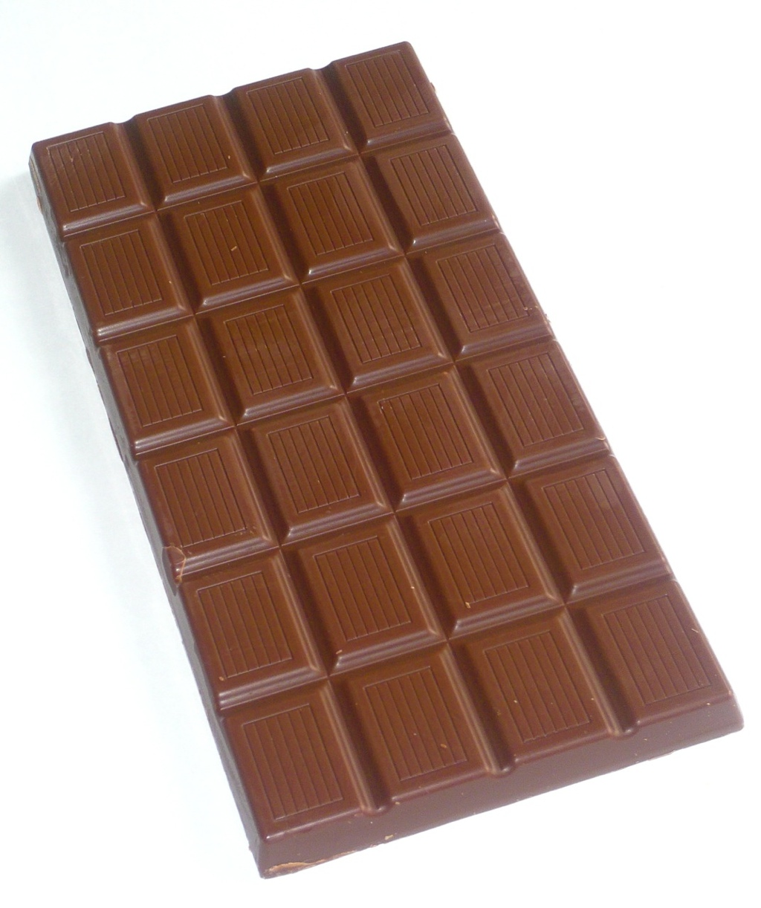
Cutting the Chocolate Block
A chocolate block is divided into squares by horizontal and vertical grooves. The object is cut the chocolate block into individual squares.
Assume each cut is made on a single piece along a groove. How many cuts are needed?
© 2006-2009 Chocablog.com (http://www.chocablog.com/reviews/ms-organic-fairtrade-milk-chocolate-with-rose/)

Slide 34
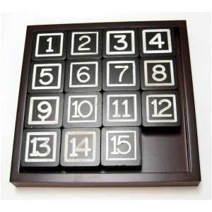
14-15 Puzzle
Consider the puzzle of sliding blocks below. Any block adjacent (left, right, above or below) the blank spot can be moved into the position of the blank spot. No diagonal moves are allowed. Can you find a series of moves so that all the blocks are in the order given, except that the 14 and 15 squares have exchanged places?
Image at: www.showmedistributors.com/items.php?id=games

